Slide 1

PHP Syntax

Slide 2
Objectives
Operators in PHP
Loop constructs in PHP
Array in PHP
Manipulation with array in PHP

Slide 3
PHP - Operator Types
PHP language supports following type of operators.
Arithmetic operators
Assignment operators
Comparison operators
Increment/Decrement operators
Logical operators
String operators

Slide 4
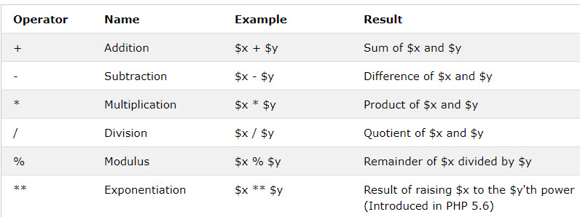
Arithmetic Operators
The PHP arithmetic operators are used with numeric values to perform common arithmetical operations, such as addition, subtraction, multiplication etc.

Slide 5
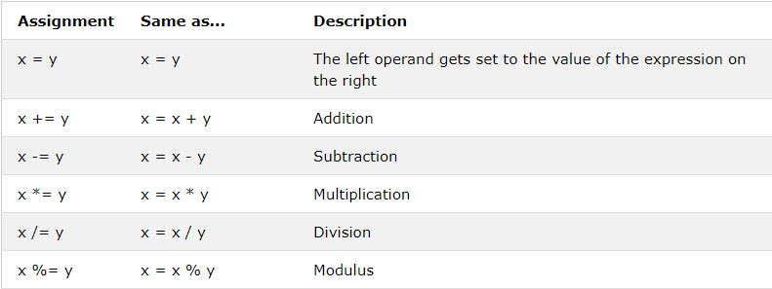
PHP Assignment Operators
The PHP assignment operators are used with numeric values to write a value to a variable.
The basic assignment operator in PHP is "=". It means that the left operand gets set to the value of the assignment expression on the right.

Slide 6
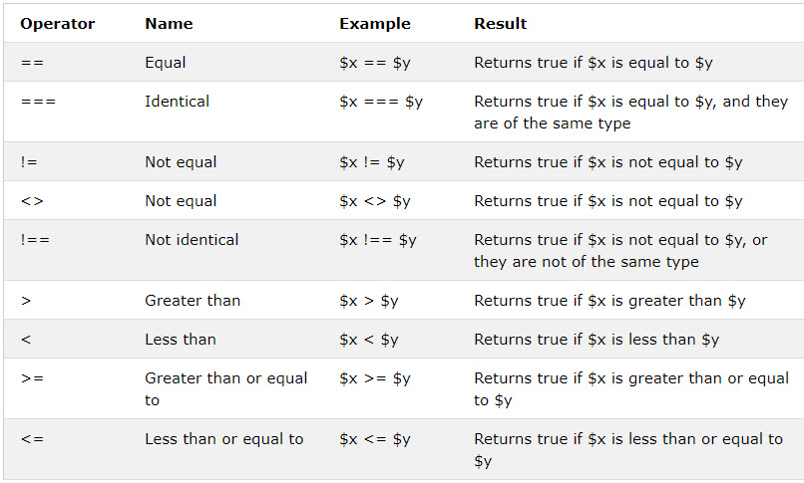
PHP Comparison Operators
The PHP comparison operators are used to compare two values (number or string)

Slide 7
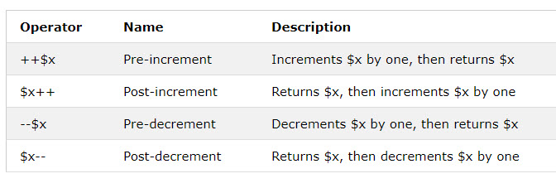
PHP Increment / Decrement Operators
The PHP increment operators are used to increment a variable's value.
The PHP decrement operators are used to decrement a variable's value.

Slide 8
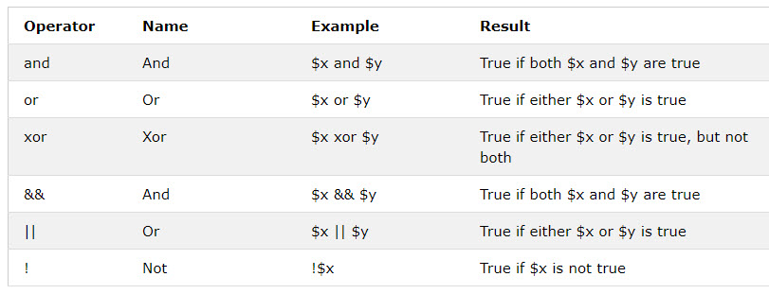
PHP Logical Operators
The PHP logical operators are used to combine conditional statements.

Slide 9
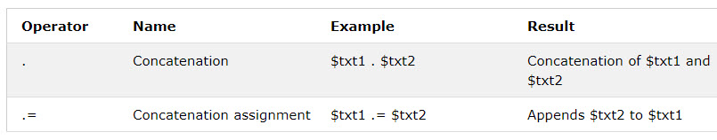
PHP String Operators
PHP has two operators that are specially designed for strings.

Slide 10
Demo
Teacher demo about operators for students

Slide 11
PHP Loops
Often when you write code, you want the same block of code to run over and over again in a row. Instead of adding several almost equal code-lines in a script, we can use loops to perform a task like this.
In PHP, we have the following looping statements:
while - loops through a block of code as long as the specified condition is true
do...while - loops through a block of code once, and then repeats the loop as long as the specified condition is true
for - loops through a block of code a specified number of times
foreach - loops through a block of code for each element in an array

Slide 12

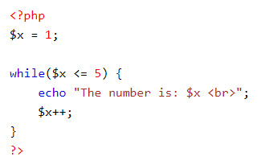
The PHP while Loop
The while loop executes a block of code as long as the specified condition is true.
Syntax
Example

Slide 13

The PHP do...while Loop
The do...while loop will always execute the block of code once, it will then check the condition, and repeat the loop while the specified condition is true.
Syntax
Notice that in a do while loop the condition is tested AFTER executing the statements within the loop. This means that the do while loop would execute its statements at least once, even if the condition is false the first time.

Slide 14
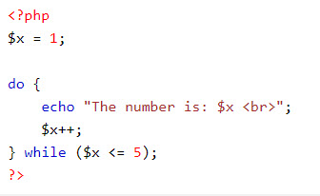
The PHP do...while Loop
Example

Slide 15

The PHP for Loop
The for loop is used when you know in advance how many times the script should run.
Syntax
Parameters:
init counter: Initialize the loop counter value
test counter: Evaluated for each loop iteration. If it evaluates to TRUE, the loop continues. If it evaluates to FALSE, the loop ends.
increment counter: Increases the loop counter value

Slide 16
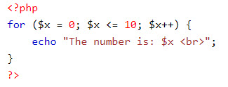
The PHP for Loop
Example

Slide 17

The PHP foreach Loop
The foreach loop works only on arrays, and is used to loop through each key/value pair in an array.
For every loop iteration, the value of the current array element is assigned to $value and the array pointer is moved by one, until it reaches the last array element.
Syntax

Slide 18
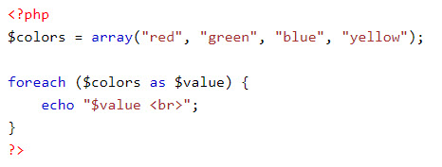
The PHP foreach Loop
Example

Slide 19
Demo
Teacher demo loop constructs for students

Slide 20
PHP array
An array is a special variable, which can hold more than one value at a time.
An array can hold many values under a single name, and you can access the values by referring to an index number.
In PHP, the array() function is used to create an array.
In PHP, there are three types of arrays:
Indexed arrays - Arrays with a numeric index
Associative arrays - Arrays with named keys
Multidimensional arrays - Arrays containing one or more arrays

Slide 21

Indexed array
There are two ways to create indexed arrays.
The index can be assigned automatically (index always starts at 0), like this:
or the index can be assigned manually:

Slide 22
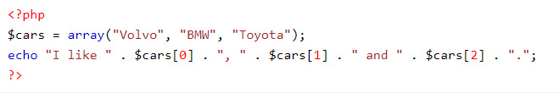

Indexed array
Example
The count() function is used to return the length (the number of elements) of an array

Slide 23
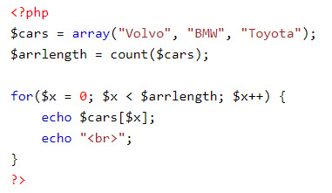
Indexed array
To loop through and print all the values of an indexed array, you could use a for loop

Slide 24

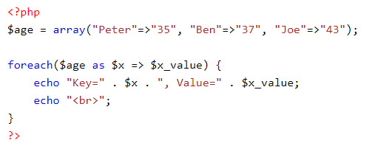
PHP Associative Arrays
Associative arrays are arrays that use named keys that you assign to them.
There are two ways to create an associative array:
or
To loop through and print all the values of an associative array, you could use a foreach loop

Slide 25
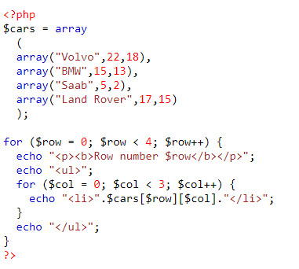
Multidimensional Arrays
A multidimensional array is an array containing one or more arrays.
Example

Slide 26
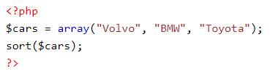
PHP - Sort Functions For Arrays
sort() - sort arrays in ascending order
rsort() - sort arrays in descending order
asort() - sort associative arrays in ascending order, according to the value
ksort() - sort associative arrays in ascending order, according to the key
arsort() - sort associative arrays in descending order, according to the value
krsort() - sort associative arrays in descending order, according to the key
Example

Slide 27
Demo
Teacher demo code about arrays for students

Slide 28
Summary
Operators in PHP
Loop constructs in PHP
Array in PHP
Manipulation with array in PHP

